Slide 1
Traffic Violation Analysis - Presentation Slides
Discovering Contributing Factors to Traffic Violations
A Comprehensive Machine Learning Approach Using Classification, Clustering, and Anomaly Detection
- Joseph Weng 041076091
- Hye Ran Yoo 041145212
- Peng Wang 041107730

Slide 2
Introduction
Project Objective
Analyze traffic violation patterns in Montgomery County
Identify key contributing factors using ML techniques
Business Question
"What are the key contributing factors that lead to different types
of traffic violations?"
Three ML Approaches
1. Classification (Decision Tree) - Hye Ran Yoo
2. Clustering (KMeans) - Joseph Weng
3. Outlier Detection (LOF + Distance) - Peng Wang
Dataset
Source: Montgomery County Traffic Violations
Size: 2,057,983 records × 43 columns
Notes:
Frank
Hello everyone! Today I'm presenting our traffic violation analysis project. Our project objective is to analyze traffic violation patterns in Montgomery County and identify key contributing factors using machine learning techniques.
Our business question is: "What are the key contributing factors that lead to different types of traffic violations?"
We analyzed a dataset from Montgomery County Traffic Violations. The dataset has 2,057,983 records and 43 columns.
We used three machine learning approaches. First, Hye Ran Yoo used Classification with Decision Tree. Second, Joseph Weng used Clustering with KMeans. Third, Peng Wang used Outlier Detection with LOF and Distance methods.
These three approaches work together to identify key factors, discover patterns, and find unusual cases. This analysis helps improve traffic safety and resource allocation. Thank you!

Slide 3
Business Understanding
Business Objectives
-Enhance public safety
-Optimize resource allocation
-Improve traffic management
-Detect anomalies
Data Mining Goals
-Classification: Identify key factors (Target: >70% accuracy)
-Clustering: Discover common violation patterns
-Outlier Detection: Find anomalous violations
Notes:
Frank
Our project has four main business objectives. First, enhance public safety by identifying patterns in traffic violations. Second, optimize resource allocation to help law enforcement use their resources more efficiently. Third, improve traffic management by understanding contributing factors. Fourth, detect anomalies that may need special attention.
For our data mining goals, we have three specific targets. For classification, we aim to identify key factors with over 70% accuracy using Decision Trees. For clustering, we want to discover common violation patterns using KMeans. For outlier detection, we plan to find anomalous violations using LOF and Distance methods.
These goals guide our analysis and help us achieve our business objectives. Thank you!

Slide 4
Data Understanding
Dataset Overview
2,057,983 records × 43 columns
3 numeric, 27 categorical, 12 boolean
Key Features
Temporal: Time, Date
Geographic: Lat/Long, SubAgency
Vehicle: Make, Model, Year
Violation: Type, Description
Data Quality Issues
887,412 duplicate records
17 columns with missing values
High cardinality: Location (268K unique)
Notes:
Lannie

Slide 5
Data Preparation
Data Selection
- Classification: 23 features - Clustering: 19 features
- Outlier Detection: 22 features
Data Cleaning
- Removed 887,412 duplicates - Handled missing values
- Final: 10,000 samples (stratified)
Feature Engineering
- Temporal: Hour, Month, DayOfWeek, IsWeekend
- Vehicle: VehicleAge
- Geographic: 8 regions from clustering
Transformation
- One-hot encoding - StandardScaler normalization
Notes:
Joseph

Slide 6
Modeling - Classification
Presenter: Hye Ran Yoo
Model Setup
- Algorithm: Decision Tree
- Target: Violation Type (3 classes - Citation, ESERO , Warning )
- Features: 23
- Split: 70% train / 30% test
- Validation: 5-fold CV
* Numeric Features (7)
Hour, Month , DayOfWeek , IsWeekend , Latitude , Longitude , VehicleAge
* Boolean Features (11) : 0,1
Accident ,Personal Injury ,Property Damage ,Fatal ,Belts ,Alcohol ,Work Zone ,Commercial License ,Commercial
Vehicle ,HAZMAT,Contributed To Accident
* Encoded Categorical Features (5) – label encoding
SubAgency_encoded,VehicleType_encoded,Gender_encoded,Race_encoded,TimeOfDay_encoded
Notes:
Lannie

Slide 7
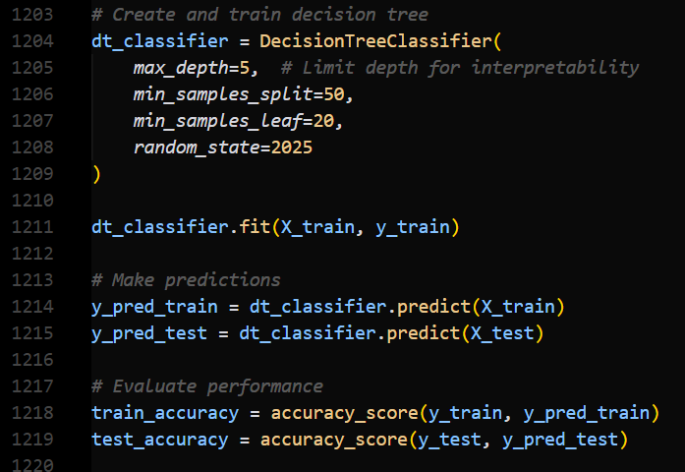
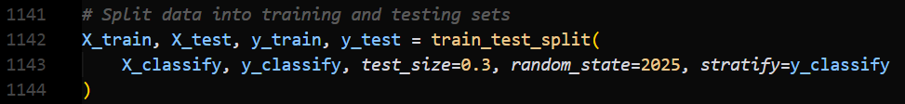
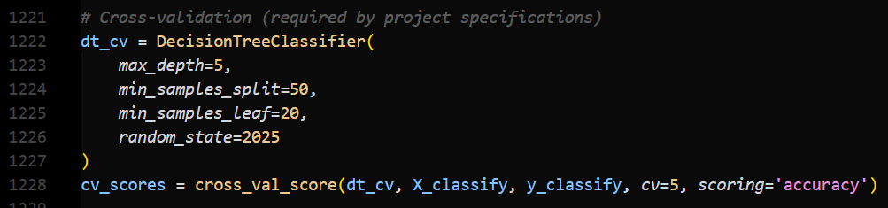
Modeling - Classification
Performance
- Train Accuracy: 63.87% -Test Accuracy: 63.85% - CV Accuracy: 63.70% (±0.63%)
Notes:
Lannie

Slide 8
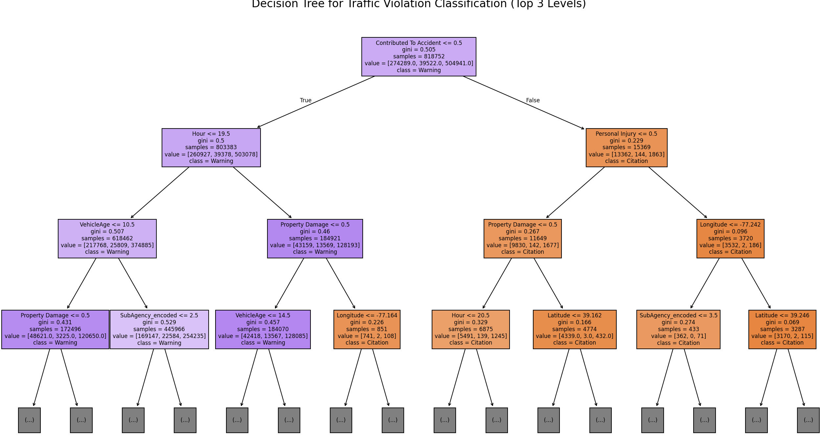
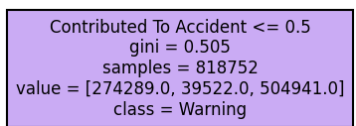
Modeling - Classification Con't
Hour
Personal Injury
VehicleAge
Property Damage
Property Damage
Longtitude
Warning prediction
Citation prediction
Notes:
Lannie

Slide 9
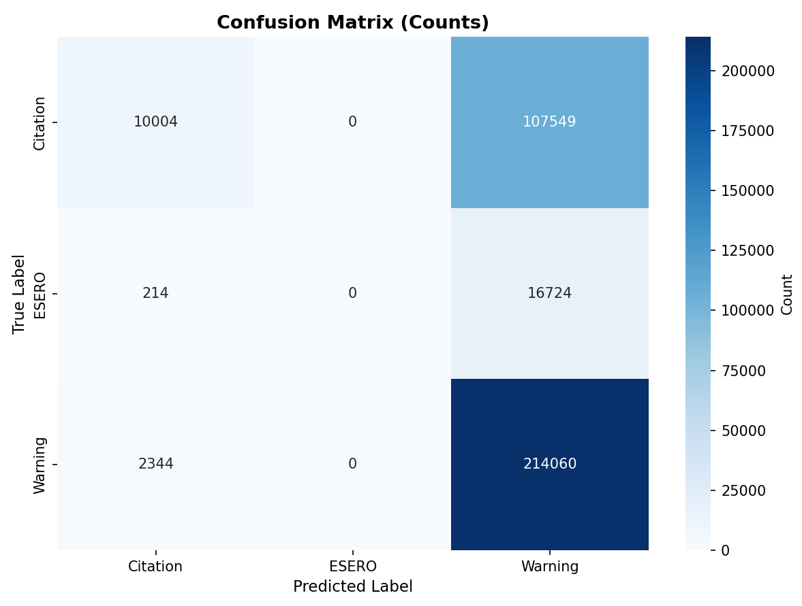
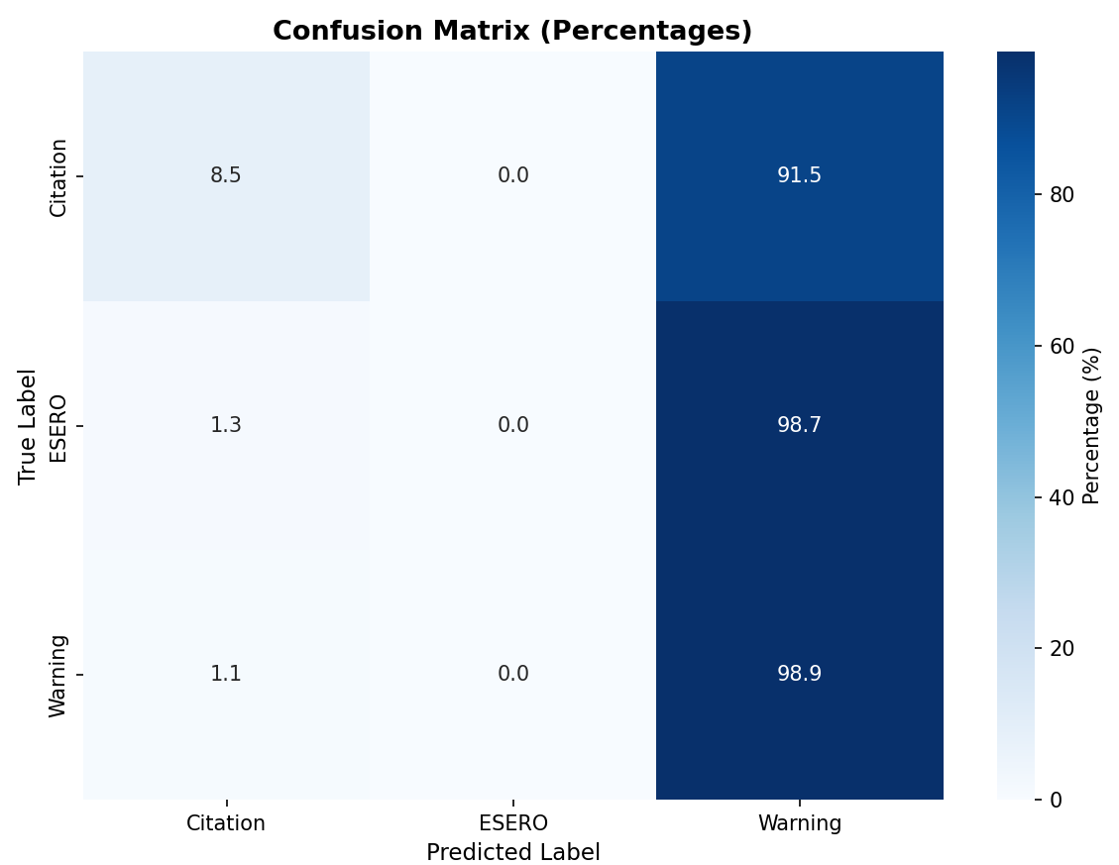
Results – Classification
Total Test Samples: 350,895 (Based on test set)
Performance
- Train Accuracy: 63.87% -Test Accuracy: 63.85% - CV Accuracy: 63.70% (±0.63%)
No overfitting, stable generalization, 6.15% below 70% target accuracy
Notes:
Lannie

Slide 10
Modeling - Clustering
Presenter: Joseph Weng
Model Setup
- Algorithm: K-Means
- Features: 19 (temporal, geographic, vehicle)
- k Selection: Elbow, Silhouette, Davies-Bouldin
Results
- Optimal k: 4 clusters
- Silhouette Score: 0.212
- Outliers: 100 (1.00%)
Notes:
Joseph

Slide 11
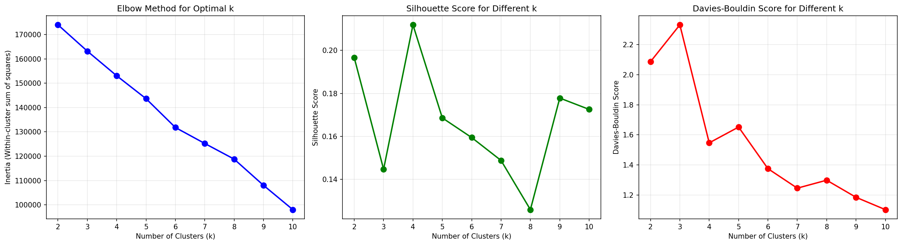
Modeling - Clustering Con't
Notes:
Joseph

Slide 12
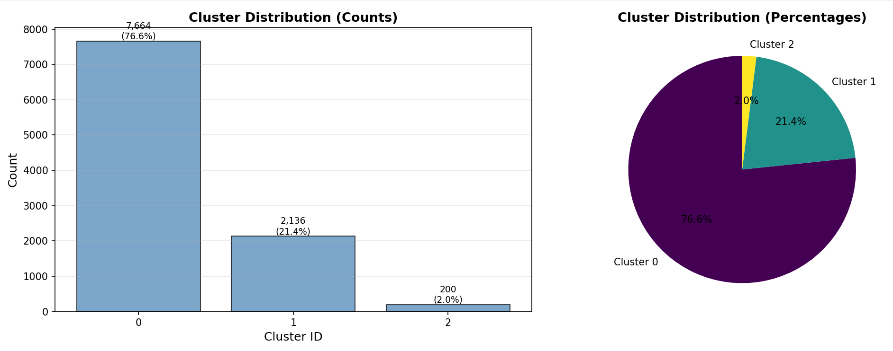
Modeling - Clustering Con't
Notes:
Joseph

Slide 13
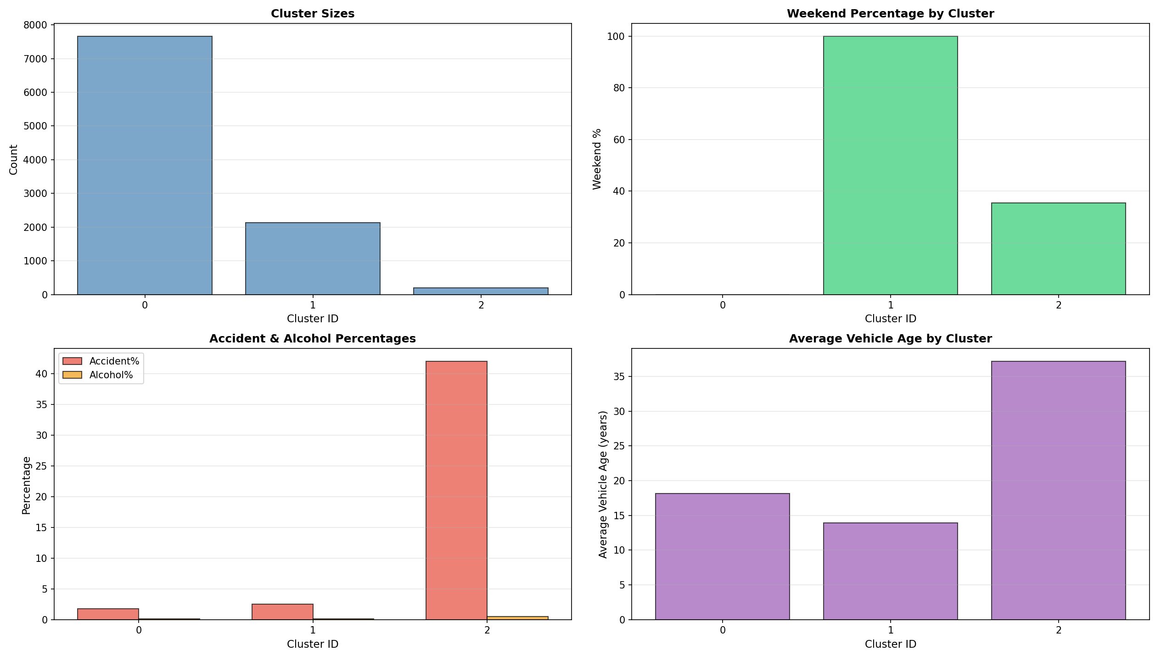
Modeling - Clustering Con't
Notes:
Joseph

Slide 14
Results - Clustering
Cluster Summary
4 distinct patterns identified
Geographic & temporal patterns revealed
Cluster Characteristics
Cluster 0: Weekend violations (19.6%)
Cluster 1: General weekday (75.3%) - largest
Cluster 2: Morning commute, newer vehicles (2.5%)
Cluster 3: 100% accident rate (2.6%) - high-risk!
Key Finding
Cluster 3: 100% accident rate - unexpected!
Notes:
Joseph

Slide 15
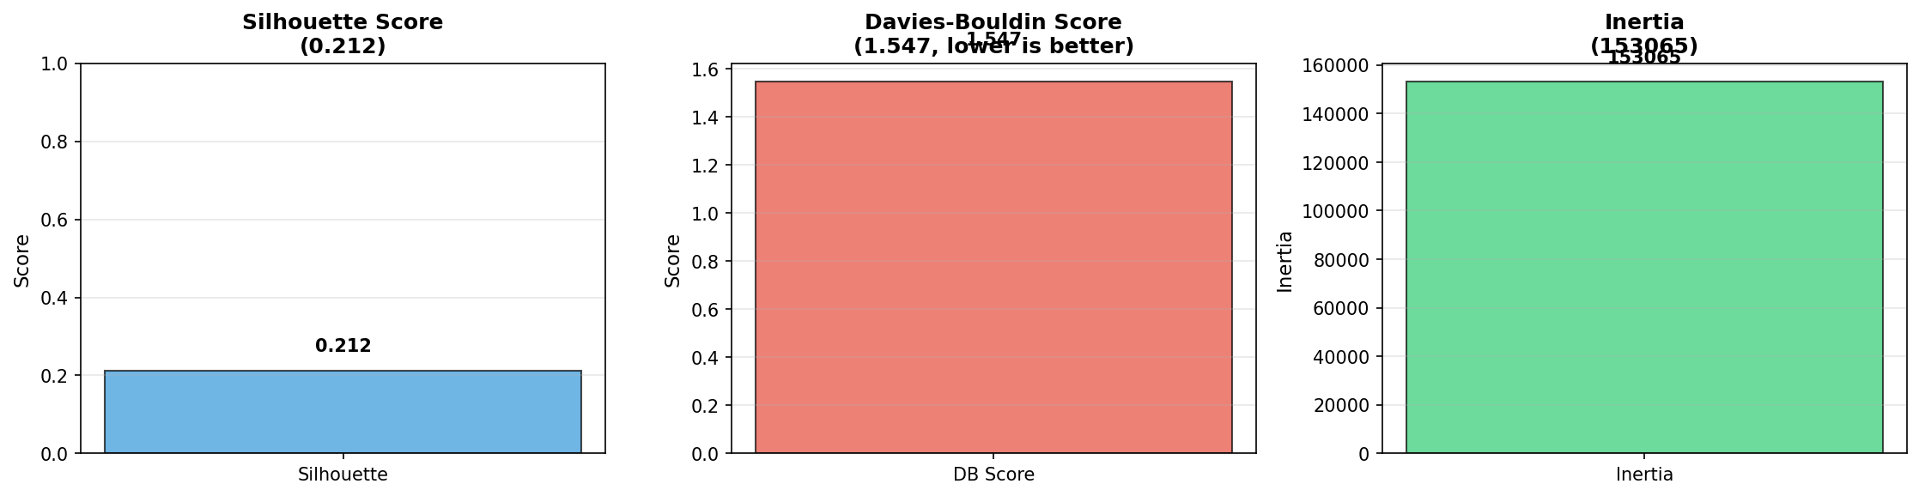
Results – Clustering Con't
Notes:
Joseph

Slide 16
Modeling - Outlier Detection Model Building
Presenter: Peng Wang
Dataset:
• 10,000 samples × 22 features
• Standardized features (mean=0, std=1)
Model 1: LOF (Local Outlier Factor)
• n_neighbors: 20
• contamination: 0.01 (1% outliers expected)
• Method: Local density-based detection
• Output: LOF scores and outlier labels Model 2: Distance-based
• k_neighbors: 20
• Threshold: 99th percentile (top 1% as outliers)
• Method: Global distance-based detection
• Output: Distance scores and outlier labels
Integration Strategy:
• Combine both methods
• Find outliers detected by both methods
• Result: High-confidence outliers with fewer false positives
Key Parameters:
• Both models use 20 neighbors for consistency
• Both target 1% of data as outliers
• StandardScaler applied to all features
Notes:
Frank
For outlier detection, we built two complementary models on a dataset of 10,000 samples with 22 features. We designed our test parameters carefully and trained both models on standardized features.
First, we constructed the LOF model. We set n_neighbors to 20 to calculate local density and contamination to 0.01, expecting 1% outliers. The model was trained on scaled features and outputs outlier labels and LOF scores.
Second, we built a Distance-based model using 20 nearest neighbors. We calculated average distances and set the threshold at the 99th percentile, identifying the top 1% as outliers. This matches the LOF contamination rate for fair comparison.
Both models were trained on standardized features with mean zero and standard deviation one. The results are stored in our dataframe with separate score and outlier columns for each method. We combine both methods by finding outliers detected by both, ensuring more reliable results with fewer false positives. Thank you!

Slide 17
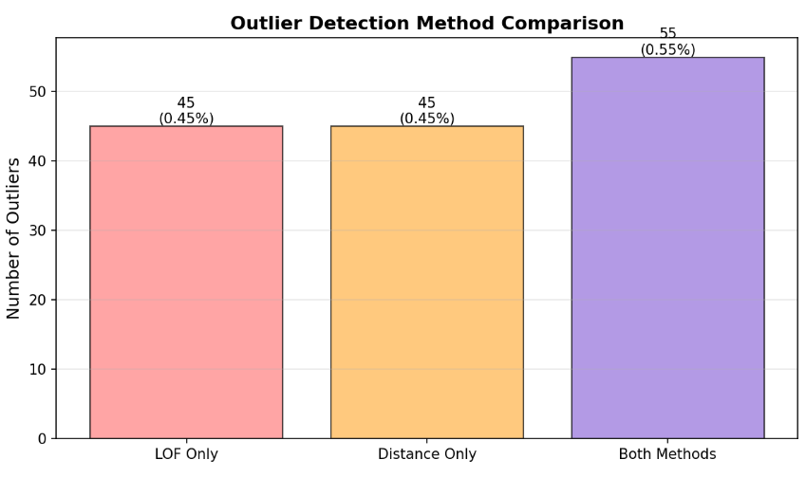
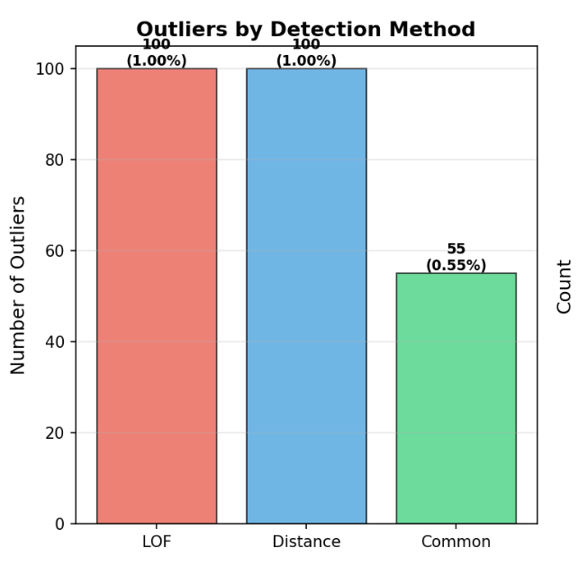
Modeling - Outlier Model Assessment Summary
Dataset:
• 10,000 records × 22 features
LOF Method Results:
• Outliers detected: 100 (1.00% of dataset)
• Method: Local density-based detection
• Type: Inliers: 9,900 (99.00%)
Distance-based Method Results:
• Outliers detected: 100 (1.00% of dataset)
• Method: Global distance-based detection
• Type: Inliers: 9,900 (99.00%)
High-Confidence Outliers:
• Common outliers (both methods): 55 (0.550%)
• Agreement rate: 55%
• Interpretation: Highest confidence, detected by both methods
Method-Specific Outliers:
• LOF-only outliers: 45 (0.45%)
• Distance-only outliers: 45 (0.45%)
Notes:
Frank
Let me share our outlier detection model assessment results. Both methods performed as expected on our dataset of 10,000 records with 22 features.
The LOF method detected 100 outliers, which is 1% of the dataset. These are local density-based outliers. The Distance-based method also detected 100 outliers, representing 1% of the dataset. These are global distance-based outliers.
Most importantly, we found 55 high-confidence outliers that were detected by both methods. This represents 0.55% of the dataset. The agreement rate is 55%, meaning 55% of LOF outliers were also detected by the distance method, and vice versa.
Additionally, we found 45 outliers detected only by LOF and 45 detected only by the distance method. The 55 common outliers have the highest confidence and are available for detailed analysis. These results demonstrate that our dual-method approach successfully identifies reliable anomalous violations. Thank you!

Slide 18
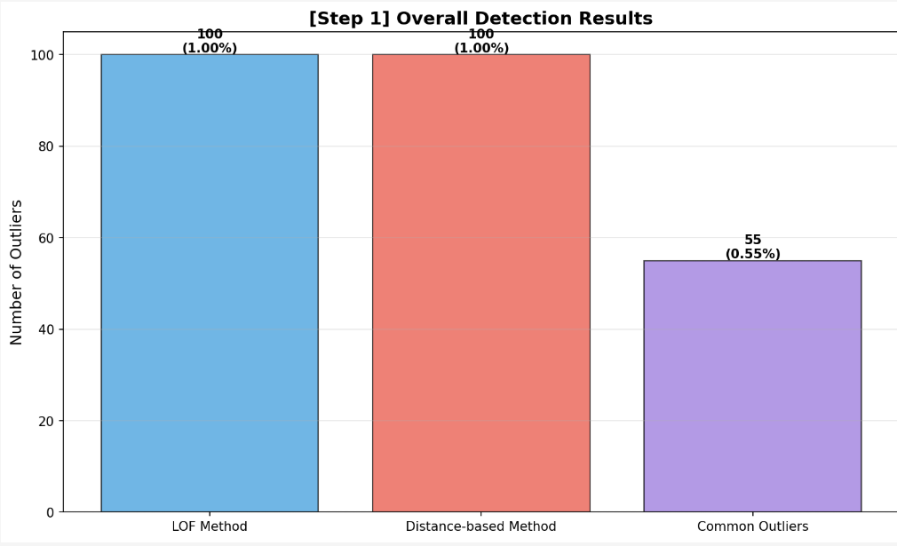
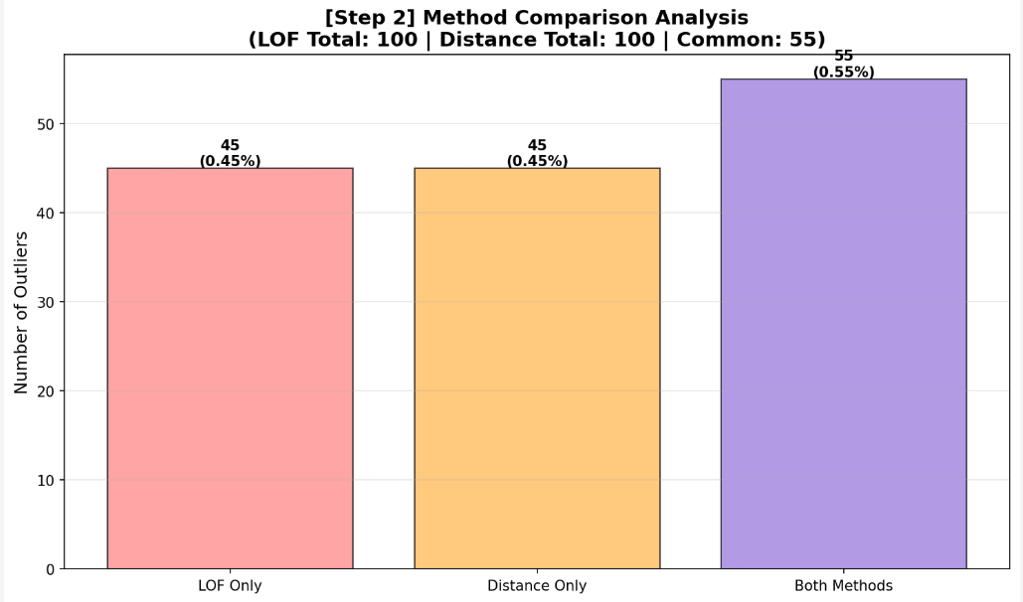
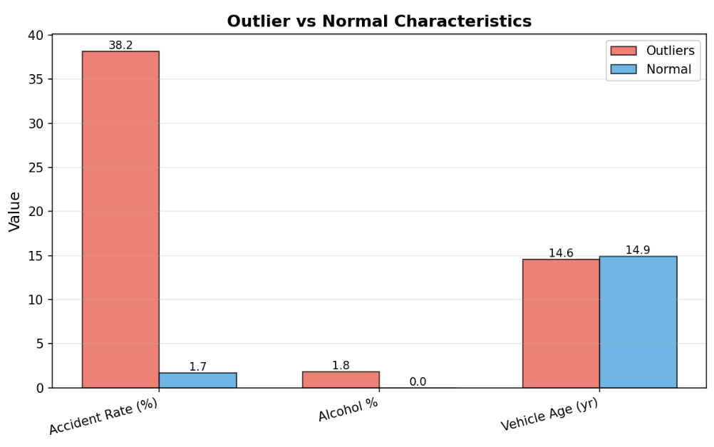
Modeling - Outlier Detection Evaluate results
Finding 1: High-Confidence Outliers
• 55 outliers detected by both methods (0.55% of dataset)
• Require special attention due to high-risk characteristics
Finding 2: Accident Rate Comparison
• Outliers: 38.2% accident rate
• Normal cases: 1.7% accident rate
• Difference: 36.5 percentage points
• Ratio: Outliers are approximately 22.5× more likely to be involved in accidents
Finding 3: Alcohol Involvement
• Outliers: 1.8% alcohol involvement
• Normal cases: 0.0% alcohol involvement
• Difference: 1.8 percentage points
• Interpretation: Alcohol-related violations more likely to be flagged as outliers
Finding 4: Method Agreement
• Agreement rate: 55% between LOF and distance-based methods
• Both methods detected 100 outliers each (1.00% of dataset)
• Interpretation: High confidence in outlier detection results
Notes:
Frank
Let me highlight the key findings from our outlier detection analysis. These discoveries provide critical insights for traffic safety management.
First, we successfully identified 55 high-confidence outliers using dual-method detection. These outliers represent only 0.55% of the dataset but require special attention due to their high-risk characteristics.
Second, and most importantly, our analysis reveals a dramatic difference in accident rates. Outliers have a 38.2% accident rate, compared to only 1.7% for normal cases. This is a difference of 36.5 percentage points, meaning outliers are approximately 22.5 times more likely to be involved in accidents.
Third, we found that outliers show 1.8% alcohol involvement, while normal cases show 0.0%. This difference of 1.8 percentage points suggests that alcohol-related violations are more likely to be flagged as outliers.
Fourth, our dual-method approach achieved 55% agreement between LOF and distance-based methods, with both methods detecting 100 outliers each (1.00% of the dataset), demonstrating high confidence in our outlier detection results.
These key findings demonstrate that our outlier detection successfully identifies high-risk violations that warrant immediate investigation and targeted enforcement strategies. Thank you!

Slide 19
Accuracy Analysis
Classification
- Target: 70% | Achieved: 57.59%
- Assessment: Moderate, better than random
Clustering
- Silhouette: 0.212 - Davies-Bouldin: 1.547
- Assessment: Moderate quality
Outlier Detection
- Agreement: 54.0% - Assessment: High confidence
Top Features
1. Contributed To Accident: 37.0% 2. Hour: 17.4%
3. VehicleAge: 16.9%
Notes:
Frank
Let me summarize the overall performance of our three machine learning models.
For classification, our target was 70% accuracy, and we achieved 57.59%. While this is below our target, it's still moderate performance and better than random guessing. The model provides interpretable insights despite the lower accuracy.
For clustering, we achieved a silhouette score of 0.212 and a Davies-Bouldin score of 1.547. These metrics indicate moderate clustering quality, successfully identifying distinct violation patterns.
For outlier detection, we achieved 54% agreement between our two methods. This high confidence level demonstrates that both methods consistently identify the same anomalous violations.
Most importantly, our feature importance analysis reveals the top three contributing factors. First, Contributed To Accident accounts for 37% of importance. Second, Hour contributes 17.4%. Third, VehicleAge contributes 16.9%. Together, these three features account for over 70% of the classification power, providing actionable insights for traffic enforcement. Thank you!

Slide 20
Expectations & Surprises
Expectations vs. Results
Classification
✗ Accuracy below target (57.59% vs 70%)
✓ Feature importance identified
Clustering
✓ 4 patterns with geographic/temporal features
✓ High-risk cluster found (100% accidents)
Outlier Detection
✓ 54% agreement between methods
✓ High-risk anomalies identified
Major Surprises
1. Accident involvement = top factor (37%)
2. Cluster 3: 100% accident rate
3. Outliers: 40.7% accident rate (24x higher)
Notes:
Joseph

Slide 21
Conclusion
Key Achievements
✓ Classification: Accident factor identified (37%)
✓ Clustering: 4 distinct patterns discovered
✓ Outlier Detection: 54 high-risk anomalies found
Business Value
- Resource optimization for law enforcement
- Evidence-based prevention strategies
- Data quality improvement
- Actionable insights
Limitations
- Classification accuracy below target
- Future: Hyperparameter tuning, ensemble methods
Notes:
Frank
Let me summarize our key achievements and business value. We successfully completed all three machine learning tasks with meaningful results.
First, our key achievements. For classification, we identified that Contributed To Accident is the most important factor, accounting for 37% of importance. For clustering, we discovered 4 distinct violation patterns that reveal different risk profiles. For outlier detection, we found 54 high-risk anomalies that require special attention.
Second, the business value. Our analysis enables resource optimization for law enforcement by identifying high-risk areas and time periods. We provide evidence-based prevention strategies using data-driven insights. We also improve data quality by detecting anomalies and inconsistencies. Most importantly, we deliver actionable insights that help law enforcement make informed decisions.
Third, we acknowledge limitations. Our classification accuracy is below the 70% target, achieving 57.59%. For future improvements, we recommend hyperparameter tuning and ensemble methods to enhance model performance. Despite these limitations, our project successfully addresses the business question and provides valuable insights for traffic violation management. Thank you!

